Slide 1
FUZZY SETS AND CRISP SETS PPTS
OBJECTIVES
1. To define the basic ideas and entities in fuzzy set theory
2. To introduce the operations and relations on fuzzy sets
3. To learn how to compute with fuzzy sets and numbers - arithmetic, unions, intersections, complements

Slide 2
OUTLINE
II. BASICS
A. Definitions and examples
1. Sets
2. Fuzzy numbers
B. Operations on fuzzy sets – union, intersection, complement
C. Operations on fuzzy numbers – arithmetic, equations, functions
and the extension principle

Slide 3
DEFINITIONS
A. Definitions
1. Sets
a. Classical sets – either an element belongs to the set or it does not. For example, for the set of integers, either an integer is even or it is not (it is odd). However, either you are in the USA or you are not. What about flying into USA, what happens as you are crossing? Another example is for black and white photographs, one cannot say either a pixel is white or it is black. However, when you digitize a b/w figure, you turn all the b/w and gray scales into 256 discrete tones.

Slide 4
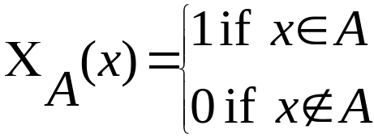
Classical sets
Classical sets are also called crisp (sets).
Lists: A = {apples, oranges, cherries, mangoes}
A = {a₁,a₂,a₃ }
A = {2, 4, 6, 8, …}
Formulas: A = {x | x is an even natural number}
A = {x | x = 2n, n is a natural number}
Membership or characteristic function
August 12, 2003
II. BASICS: Math Clinic Fall 2003

Slide 5
Definitions – fuzzy sets
b. Fuzzy sets – admits gradation such as all tones between black and white. A fuzzy set has a graphical description that expresses how the transition from one to another takes place. This graphical description is called a membership function.

Slide 6
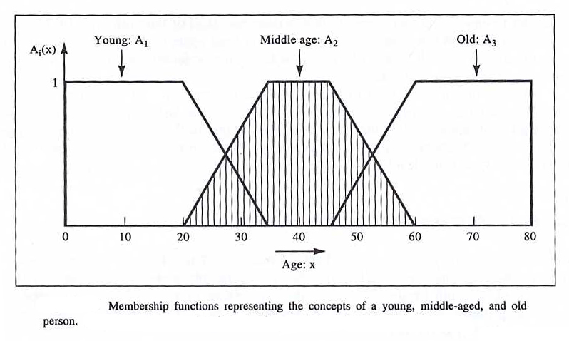
Definitions – fuzzy sets (figure from Klir&Yuan)

Slide 7
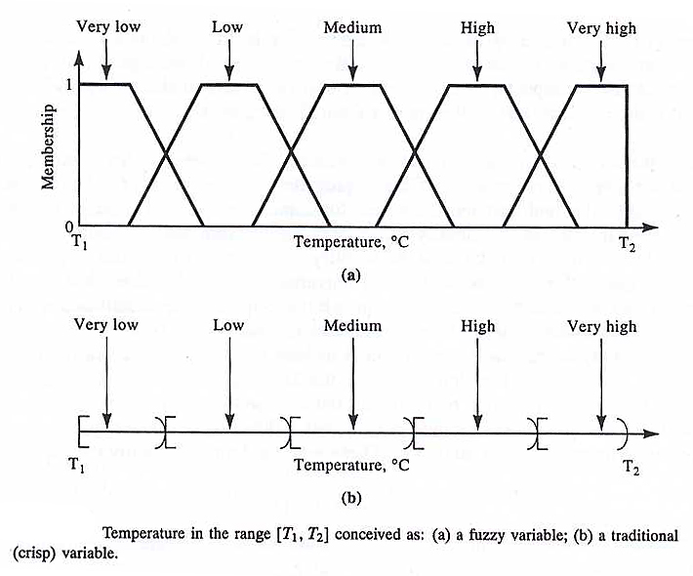
Definitions: Fuzzy Sets (figure from Klir&Yuan)
August 12, 2003
II. BASICS: Math Clinic Fall 2003

Slide 8
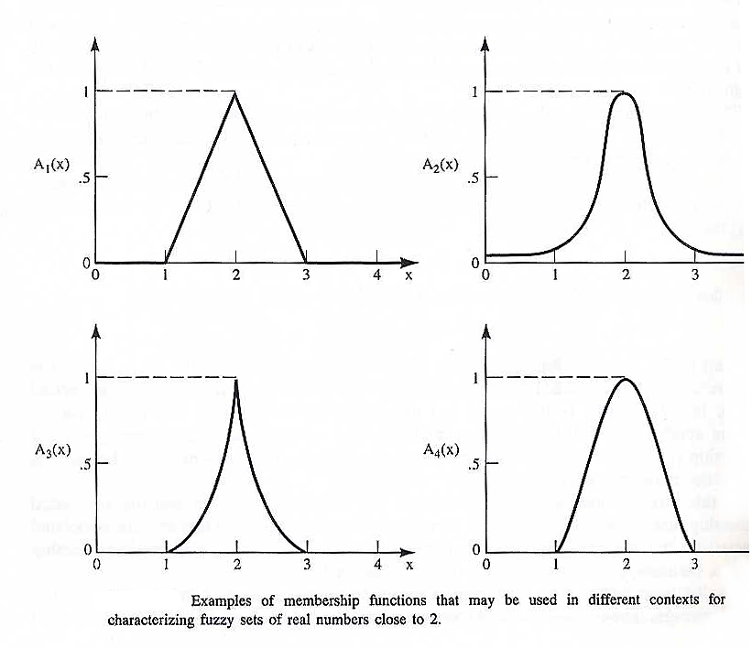
Membership functions (figure from Klir&Yuan)

Slide 9
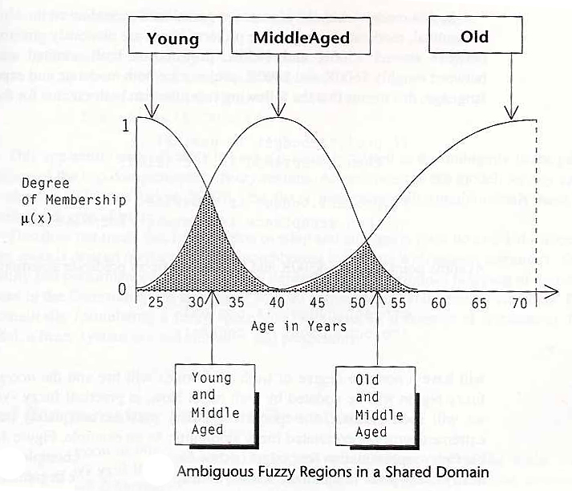
Fuzzy set (figure from Earl Cox)

Slide 10
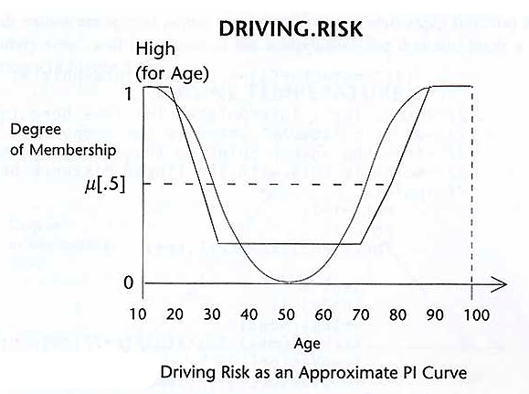
Fuzzy Set (figure from Earl Cox)

Slide 11
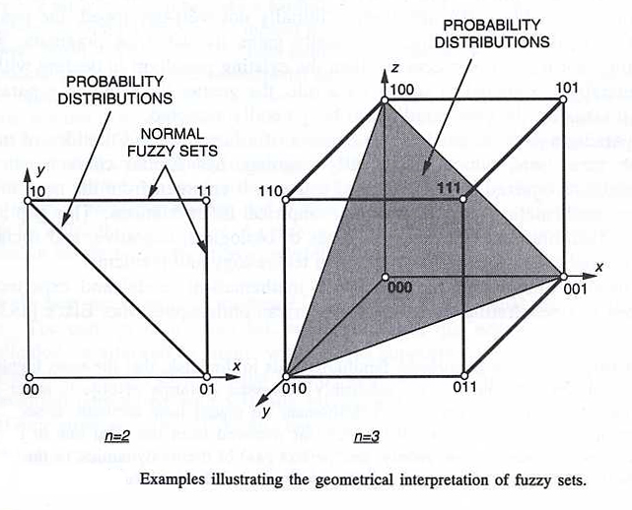
The Geometry of Fuzzy Sets (figure from Klir&Yuan)

Slide 12
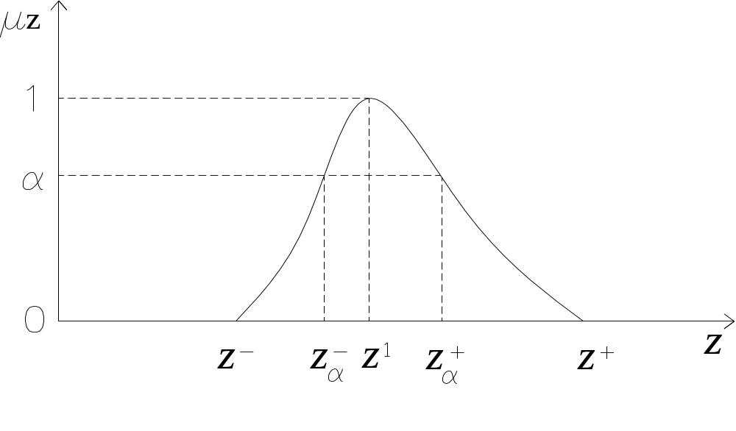
Alpha levels, core, support, normal

Slide 13


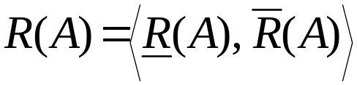
Definitions: Rough Sets
A rough set is basically an approximation of a crisp set A in terms of two subsets of a crisp partition, X/R, defined on the universal set X.
Definition: A rough set, R(A), is a given representation of a classical (crisp) set A by two subsets of X/R, and
that approach A as closely as possible from the inside and outside (respectively) and
where and are called the lower and upper approximation of A.

Slide 14
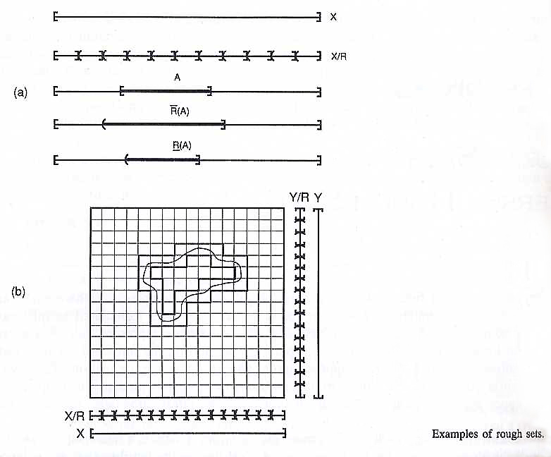
Definitions: Rough sets (figure from Klir&Yuan)

Slide 15
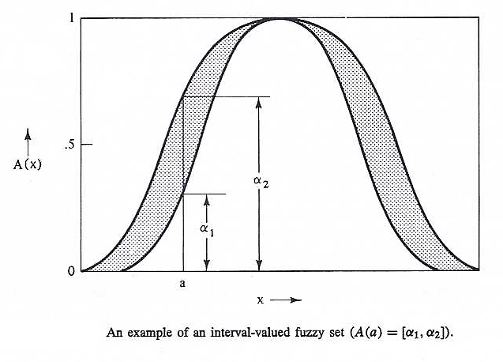
Definitions: Interval Fuzzy Sets (figure from Klir&Yuan)

Slide 16
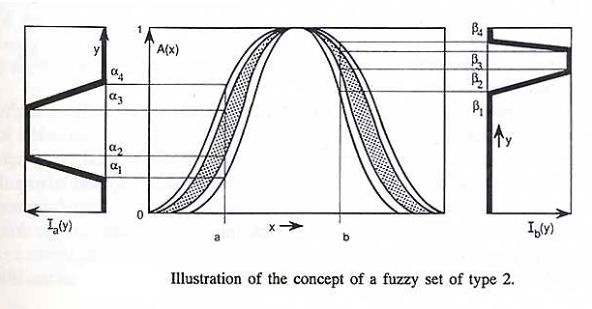
Definitions: Type-2 Fuzzy Sets (figure from Klir&Yuan)

Slide 17



2. Fuzzy Number
A fuzzy number A must possess the following three properties:
1. A must must be a normal fuzzy set,
2. The alpha levels must be closed for every ,
3. The support of A, , must be bounded.

Slide 18










Fuzzy Number (from Jorge dos Santos)
is the suport of
z¹ is the modal value
1
α’
Membership function
α
is an α-level of , α (0,1]

Slide 19










Fuzzy numbers defined by its α-levels (from Jorge dos Santos)
A fuzzy number can be given by a
set of nested intervals, the α-levels:
1
.7
.5
.2
0

Slide 20





Triangular fuzzy numbers
1

Slide 21
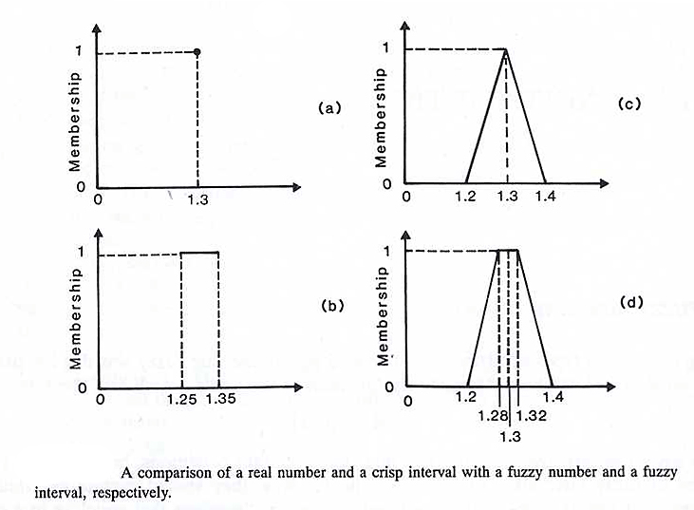
Fuzzy Number (figure from Klir&Yuan)

Slide 22
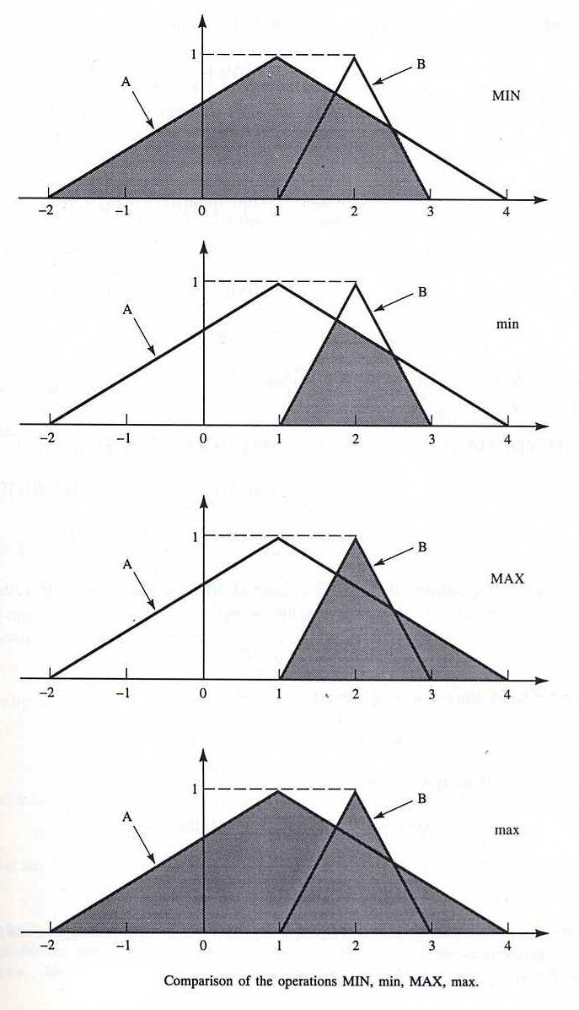
B. Operations on Fuzzy Sets: Union and Intersection (figure from Klir&Yuan)

Slide 23
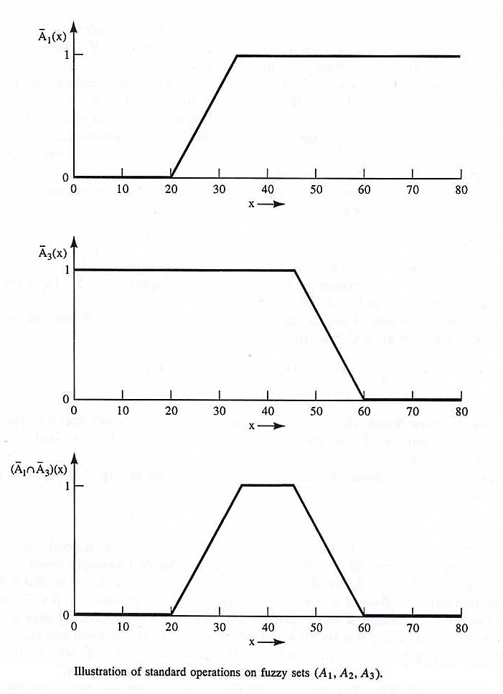
Operations on Fuzzy Sets: Intersection (figure from Klir&Yuan)

Slide 24
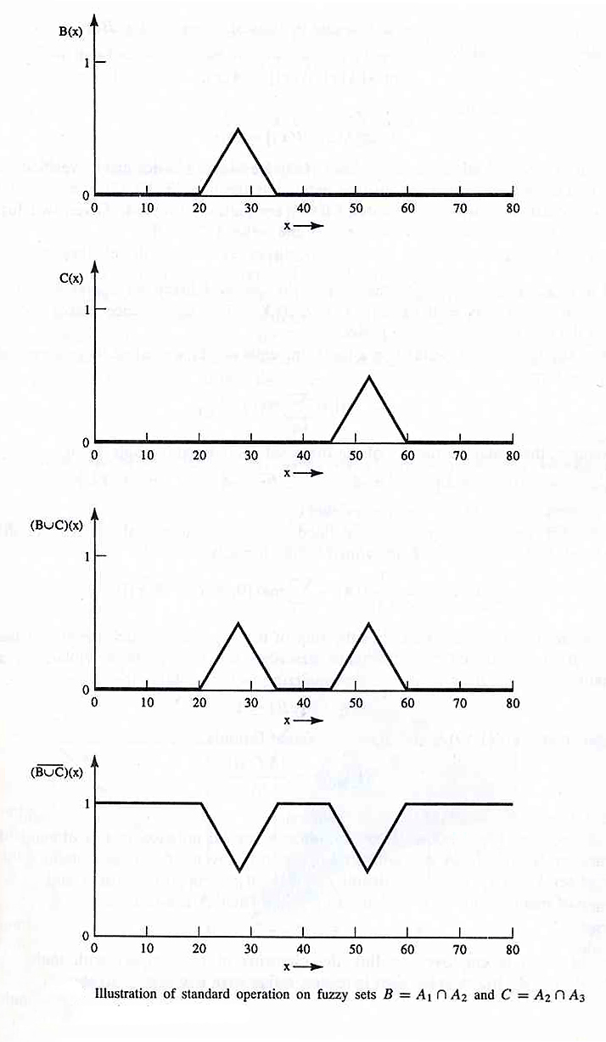
Operations on Fuzzy Sets: Union and Complement (figure from Klir&Yuan)

Slide 25
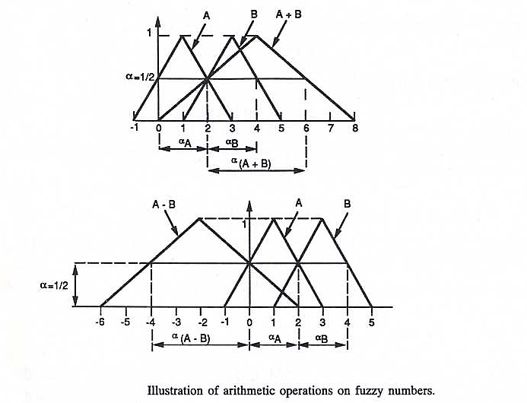
C. Operations on Fuzzy Numbers: Addition and Subtraction (figure from Klir&Yuan)

Slide 26
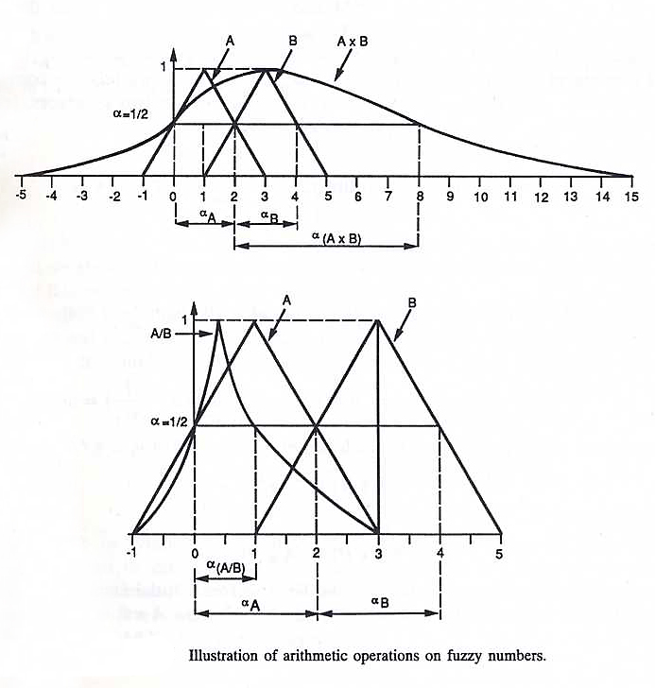
Operations on Fuzzy Numbers: Multiplication and Division (figure from Klir&Yuan)

Slide 27
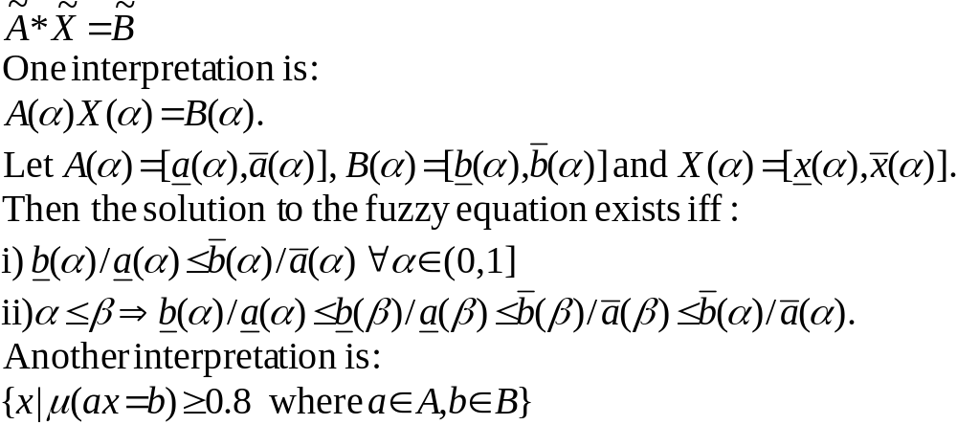
Fuzzy Equations

Slide 28
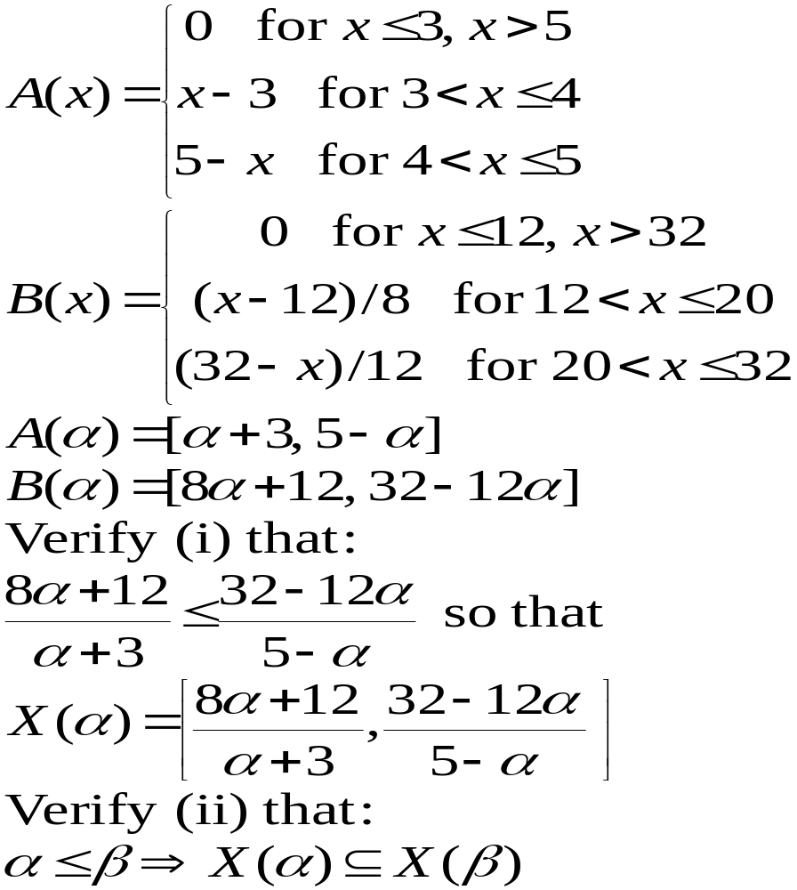
Example of a Fuzzy Equation (figure from Klir&Yuan)

Slide 29


The Extension Principle of Zadeh
Given a formula f(x) and a fuzzy set A defined by,
how do we compute the membership function of f(A) ?
How this is done is what is called the extension principle (of
professor Zadeh). What the extension principle says is that
f (A) =f(A( )). The formal definition is:
[f(A)](y)=sup_{x|y=f(x)}{ }

Slide 30
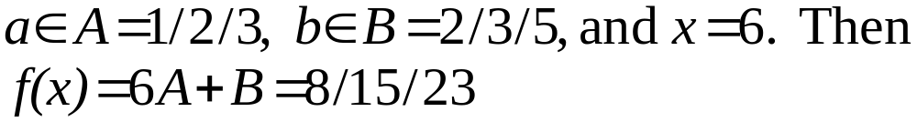
Extension Principle - Example
Let f(x) = ax+b,

